Slide 1
“SDIA An Opportunity of Internationalization”
IWES 2016 Pisa, Italy 20 September 2016
“Meeting with Industry”

Slide 2
Agenda
Why Small
SME from Subcontracting to....... Main Role
SDIA “A new model – Internationalization
SDIA Vision, Mission & Organization
SDIA Business Case: “NATO Research & Procurement Environment”
Conclusions

Slide 3
Why Small?
The future of the industrial activities of each country is inextricably linked to small businesses and innovative research (i.e.: EU Horizon 2020).
Small Business Companies are key to competitiveness, supporting structure of the real economy and the processes of development.
Small Business Companies are place of integration and construction of memberships.

Slide 4
Small Businesses
Small businesses are able to combine competition and efficiency along with proximity and social cohesion.
They make-up a world that innovates, produces employment and increases knowledge.

Slide 5
SME: Subcontracts......
Small businesses operating in the field of Security, Defence and Dual Systems-SD&D (and not only....) must find in the market, rather than subcontracting, the deeper reasons of their being.
The market is driven by investment and private initiative, without aid and subsidies, without protected markets, without monopolies and revenue.
The subcontracting requires a subjection and rules of behaviour that often fail to ensure growth.

Slide 6
… and … Prime Contracts
In a few cases, however, they have shown to know how to measure well with the new competitive scenarios.
They have made the transition from work to produce new technologies up to compete.
They have strong roots in the area and explore the world they know.

Slide 7
A new model – the Internationalization
Small businesses operating in the field of SD&D can become bearers of a new way of doing business in terms of economic development and the social dynamic.
Academia and Research Centres “may” participate in providing the essential research glue which supports SMEs producing innovative solutions and new technologies.

Slide 8
A new model – the Internationalization
Participating in the change of the reference codes in international and national scenarios with which to compare, made of risks and opportunities.
They know that development and growth are not ensured from the start, but depend on the quality and strength of the choices made in the field and new forms of representation and cooperation.

Slide 9
Vision
SDIA to be an International «trainer» or «metacustomer», able to increase the value of SMEs & Academia for their benefit and stimulate interest to the Customer”

Slide 10
Mission
SDIA is a new representation of SMEs & Academia, in the field of SD&D whose mission is
To give identity, visibility, representative capacity and representation.
To overcome subcontracting and to rebalance the representation of small businesses in a framework that would explain its concrete contribution.
To help modernize the business representative and the presence of the first level in the international scenario/market as a new opportunity.

Slide 11
Organization & Membership
Ordinary Members are the those which belong to the following categories:
Small Industries (up to 20);
Medium Industries” (from 20 a 400);
Academia /Research Centres (at Department level);
Other similar Bodies;
“Ad-Hoc Committees”.
Coordination & Secretariat: AOS
These Entities can apply to became Ordinary Members

Slide 12
AOS
AOS: Atlantic Organization for Security, Belgian Company.
AOS is member of the US consortium NCOIC and also participate to AGORIA in Belgium, AFCEA (NATO Chapter, International Chapter).
AOS team Is composed by Senior Managers & Senior Engineers from Industries, Research Institutions with large experience in the International business arena.

Slide 13
SDIA support
SDIA has the following main objectives:
Support SME, Academia & Research Centres to “enter” in SD&D International scenario/market, helping them:
to the definition of the better approach for cooperation with other Industries/Academia;
to participate to research/feasibility studies;
to prepare to respond to specific request for proposals (RfP);

Slide 14
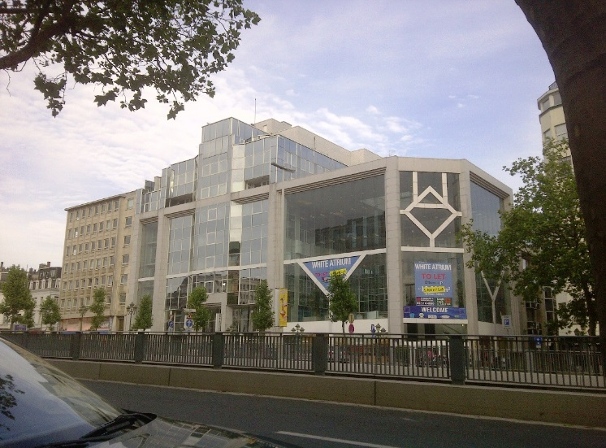
Headquarters
Rue du Kent, 30 1140 Brussels
(Branch Offices also in Rome & Paris)
http://www.sdia-eu.com

Slide 15
SDIA
SDIA Business Case: NATO Research & Procurement Environment

Slide 16
SMEs and NATO Capability Development (June 2016)
… Heads of State and Government of NATO’s 28 member Nations acknowledged the importance of SMEs at the Wales Summit in September 2014 …
AIM
The aim of this paper is two-fold: to help raise awareness on, and improve understanding of, the potential of SMEs, and second, to initiate a debate on whether NATO needs to develop specific mechanisms to facilitate SMEs' involvement in capability development. If the answer to the second part is positive, then to develop and implement those mechanisms.

Slide 17
SME and NATO Capability Development (June 2016)
Lack of definition. Lack of Information:
At least two primary aspects are related to information sharing - information about SMEs, and information for SMEs.
First, regarding the status, capability and the current participation of the SMEs, most of the information is available only nationally. At EU level the SMEs are treated in general, without clear distinction between defence, security and the others.
Second, regarding information on opportunities for SMEs, for example related to NATO procurement procedures, NATO capability requirements as well as other SMEs initiatives and good practices

Slide 18
NATO Research & Procurement Environment
NATO Procurement Organisation (NPO) – Program Offices
NATO Alliance Ground Surveillance Management Agency (NAGSMA)
NATO Support & Procurement Agency
Transportation
Pipelines
Security & Defence Systems
Infrastructures
NATO Communications and Information Agency
Command Support Structure
Air Command & Control (ACCS)
Support to Operations
Intelligence Sharing
Cyber Security
Satcom
NATO Science and Technology Organisation
Programme Office for Collaborative Science and Technology
Centre for Maritime Research and Experimentation
NATO Helicopter Management Agency (NAHEMA)
NATO Airborne Early Warning Management Agency (NAPMA)
Logisitcs

Slide 19
SDIA support
NATO
Sponsoring c/o NATO organizations (HQ, ACO, ACT), NATO Agencies (NCIA, NSPA …) and Delegations
Support to the participation to studies STO / NIAG / ACT
Support for the application to the ‘Basic Ordering Agreement” (BOA) e other partnership agreement ‘Framework for Collaborative Interaction” (FFCI)
Support for the participation to dedicated presentation at the NATO HQ or other NATO Organizations (CoIs)
Industry vs NATO
Coaching / Mentoring
Assistance in the definition phase of Industrial NDA, MOU, CA for the Teaming and Agreements to answer to RfP
Support to the Programme Management according to the NATO Standards

Slide 20
SDIA support
Data collection and Medium Term Analysis (3 year) of Principal NATO Agencies and Organizations with reference of the areas of interest
Market Analysis for new research and commercial opportunities («antenna» c/o NATO).
Evaluation of specific business opportunities and preparation to BIDs
Assistance and Support for the Proposal Preparations, «Red Team» evaluation, search for potential partners.
Promotion and organization of Company presentation to NATO
AOS Brief (newsletter) and Dedicated Reports for specific opportunities.

Slide 21
NATO:ACT “leading the transformation”

Slide 22
NATO Domain of Interest
Cyber Defence
Big Data /Analytics
IOT
C4ISR
Satellite Comms
Cognitive Computing
Global Ubiquitous Comms
Artificial Intelligence
Cryptography
Cloud Computing
Micro/Nanotechnologies
M&S

Slide 23
Conclusions
SDIA as a new International player
New model of Internationalization
New opportunities for SMEs/Academia
NATO R&P environment & Domain of Interest
“Invite talented SMEs & Academia to join SDIA”

