Slide 1
Embedded system activities at the Department of Electronics and Telecommunications
Luciano Lavagno luciano.lavagno@polito.it

Slide 2
Challenges
Continuously changing landscape (technology, integration scale, complexity, application domains)
Truly global industry
Balance basic and applied research
Meet the funding requirements of state-of-the art research facilities, through an extensive network of local, national, European and global cooperations

Slide 3
Research expertise portfolio
Devices
Nanoscale devices
Quantum-dot light-emitting devices
Organic electronics
Solar cells
Circuits
Asynchronous circuits
Latency-insensitive circuits
Optical circuits
Analog electronics
Microwave electronics
Methods/tools
Electro-Magnetic Compatibility analysis and optimization
High-level synthesis
Wireless Sensor network design tools
Technology CAD
Systems
Nano-satellites
Mechatronic systems
Wireless sensor networks
Smart sensors
Artificial Neural Networks

Slide 4
Research expertise portfolio
Devices
Nanoscale devices
Quantum-dot light-emitting devices
Organic electronics
Solar cells
Systems
Nano-satellites
Mechatronic systems
Wireless sensor networks
Smart sensors
Artificial Neural Networks
Circuits
Asynchronous circuits
Latency-insensitive circuits
Optical circuits
Analog electronics
Microwave electronics
Methods/tools
Electro-Magnetic Compatibility analysis and optimization
High-level synthesis
Wireless Sensor network design tools
Technology CAD

Slide 5
Research expertise portfolio
Methods/tools
Electro-Magnetic Compatibility analysis and optimization
High-level synthesis
Wireless Sensor network design tools
Technology CAD
Devices
Nanoscale devices
Quantum-dot light-emitting devices
Organic electronics
Solar cells
Circuits
Asynchronous circuits
Latency-insensitive circuits
Optical circuits
Analog electronics
Microwave electronics
Smart Sensors
Systems
Nano-satellites
Mechatronic systems
Wireless sensor networks

Slide 6
VLSI Design Group
Areas of expertise:
VLSI architectures,
digital circuits for telecommunications and multimedia,
Micro&Nano Systems,
Sensing Devices,
System Integration,
multicore SoCs
Tools:
CAD for VLSI, high-level synthesis, MEMS and Electronics
AFM/STM Microscope, Electrical Characterization, ab-initio simulations
Labs:
VLSI Lab
MiNES Chivasso

Slide 7
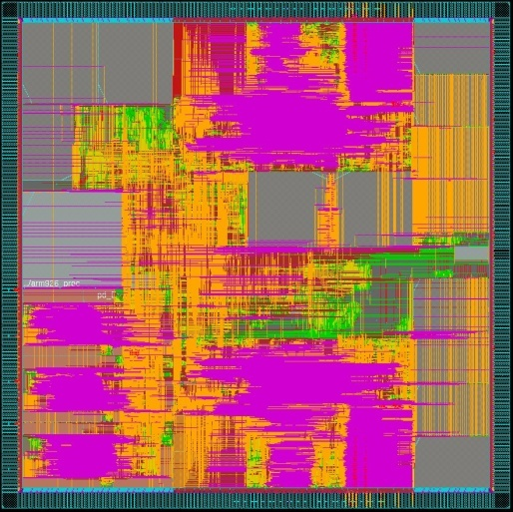
Digital Baseband processing architectures
Convergence of communication standards demands for flexible AND efficient architectures
very difficult for high complexity processing tasks
Example: Multi-standard channel decoders: one HW for many heterogeneous error correcting codes
Joint HW-algorithm optimization!
Simplify decoding algorithms
Find commonalities
Develop unified low complexity algorithms
DVB
H-T
3GPP, LTE
802.16e
and next gen.
802.11n
and next gen.
Flexible HW (e.g. Multi-ASIP architecture)
Flexible interconnect architecture
Reference:guido.masera@polito.it
7

Slide 8
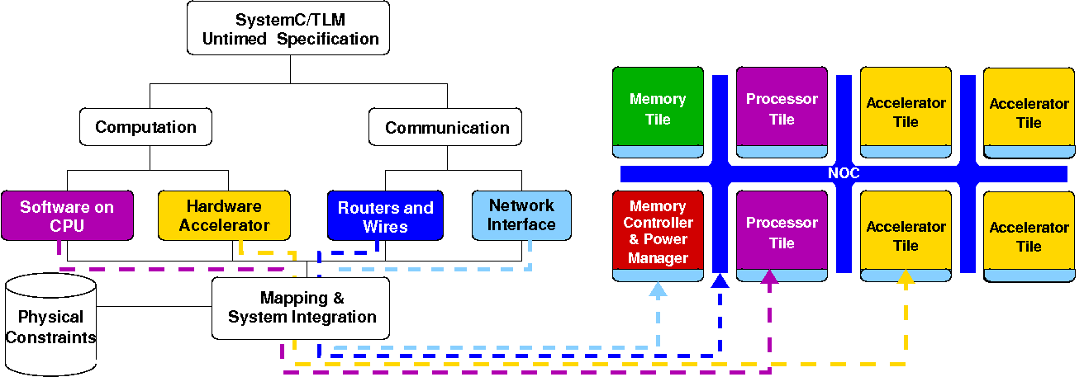
Platform architecture for multicore SoCs with specialized accelerators
Basic approach:
Specialized hardware “accelerators” for energy efficiency
Regular tiled approach with NoC-based inter-tile communications
Specific topics:
Virtual platform for fast HW/SW co-simulation
High-level synthesis of accelerators and network-interfaces
Dynamic Voltage and Frequency Scaling (DVFS) for tiles and NoC
Latency-Insensitive RTL design of processor/memory
Parameterized synthesis of NoC
HW/SW interaction through platform API
Platform Services and Tile Managers
Reference: Mario Casu mario.casu@polito.it

Slide 9
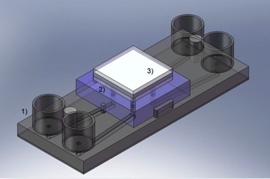
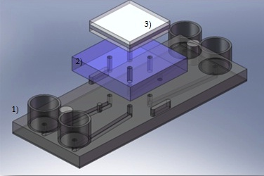
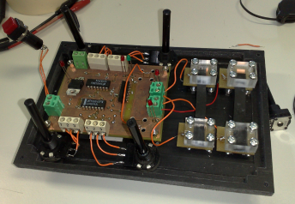
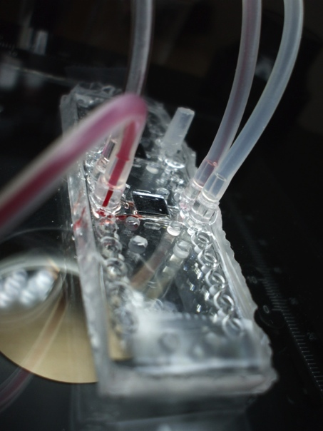
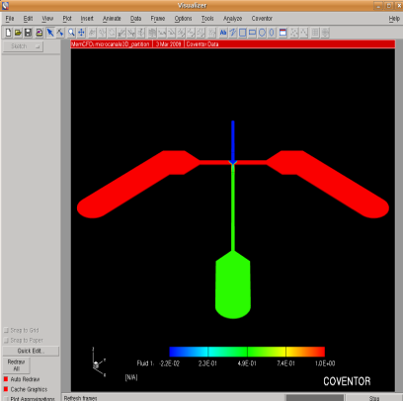
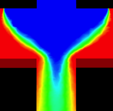
System and micro-system integration
Smart packaging
Microfluidics
Polymeric electronics
Reference:danilo.demarchi@polito.it
Electronics Group
9

Slide 10
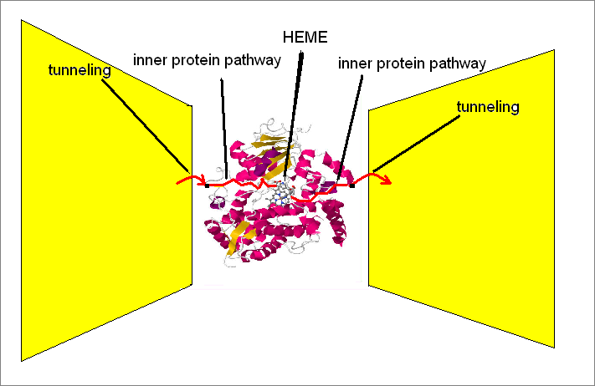
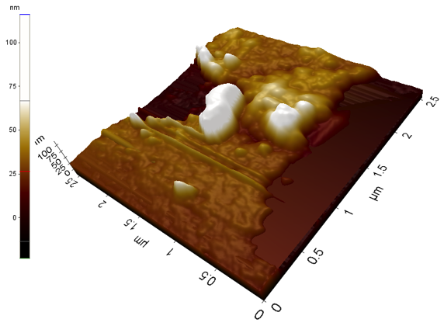
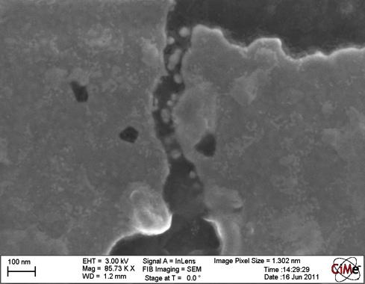
Biosensors
Development of nanocontacts: nanogaps
Single Molecule Sensing
Molecular Level Modelling
Analysis and Detection of Proteins
OligoThioPhenes based devices for electronics and opto or bio sensing
Reference:danilo.demarchi@polito.it
Electronics Group
10

Slide 11
Micro-Electronics Group
Areas of expertise:
Nano-satellites
Wireless Sensor Networks and their design methods and tools
Advanced hardware design methods and tools
Embedded systems and control algorithms for mechatronics
Artificial Neural Networks and Smart Sensors
Tools:
CodeSimulink: HW/SW co-design from Simulink models
Wireless Sensor Network design from Stateflow/Simulink models
Labs:
Pick&place for PCB, soldering oven
Sun simulator, ground station for satellites (VHF, UHF, S-band)
Laboratorio Interdipartimentale di Meccatronica (LIM)
Neuronica Laboratory: Artificial Neural Networks and Smart Sensors

Slide 12
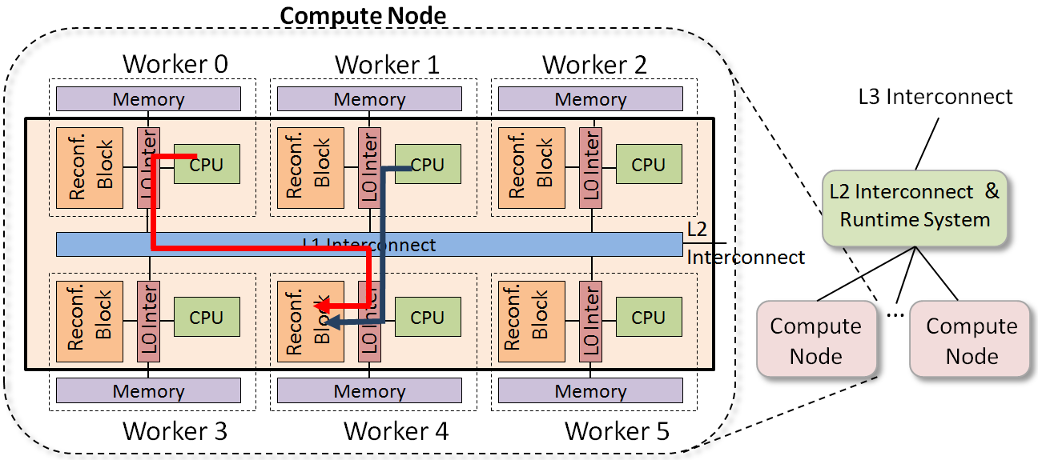
High-Level Synthesis from concurrent models
Goal: reduce design cost and improve quality of results through Design Space Exploration
Same design ease and platform reuse as SW flow, performance and power efficiency comparable to HW flow
Modeling using Simulink, C++, OpenCl
Implementation on ASIC or FPGA (for data centers)
Collaborations with Mentor Graphics, Xilinx
Contact: Luciano Lavagno (luciano.lavagno@polito.it)

Slide 13
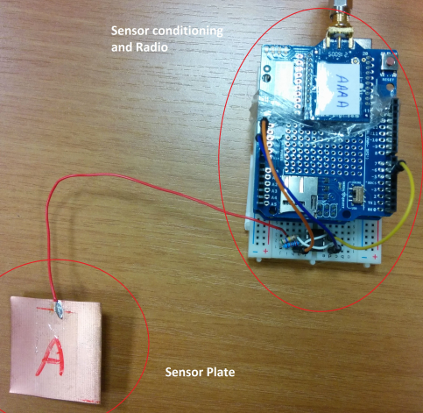
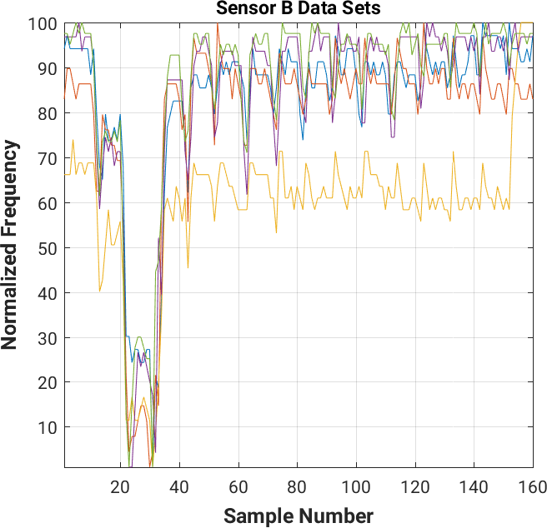
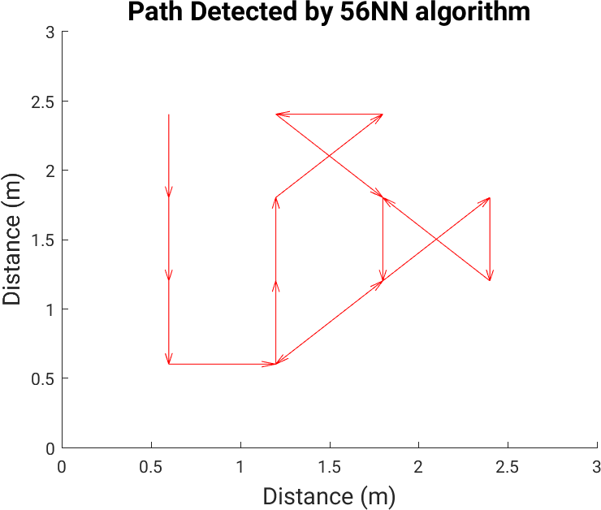
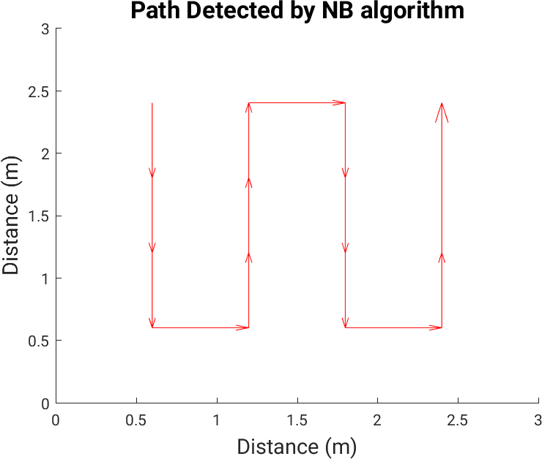
Capacitive sensing for indoor location
Application to assisted living for elderly people
Requirements: tagless, passive, privacy-aware, unobtrusive
16x16cm copper plate, in RC oscillator
Main challenge: very low SNR
Contact: Mihai Lazarescu (mihai.lazarescu@polito.it)

Slide 14
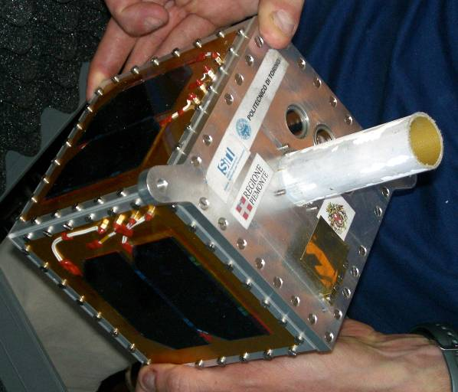
HW/SW for Low Cost Avionics
Component selection, testing and for space applications
Reconfigurable power management systems for satellites
Increasing system-level reliability by mixing HW and SW redundancy
Satellite telecommunication systems
On board embedded systems
Intelligent harness for data and power distribution inside satellite
HW/SW codesign techniques based on UML to simplify satellite design, integration and testing
Modular architectures for low-cost satellites
Contact: Leonardo Reyneri (leonardo.reyneri@polito.it)

Slide 15
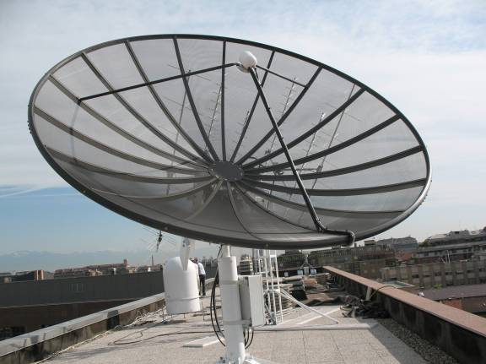
International cooperation: Zero Robotics and SPHERES
Zero Robotics: Competition among US and EU high schools to program the MIT space robot SPHERES inside the International Space Station
In 2011 Competition, three Piedmont schools won the 1st, 2nd, 3rd place in Europe
In 2012, coordinating 25 high schools around Italy (ongoing competition)
European Technical Coordination of the Zero Robotics Competition
Currently working to develop an European SPHERES Research Lab in Torino, in cooperation with TAS and IIT
Contact: Leonardo Reyneri (leonardo.reyneri@polito.it)

Slide 16
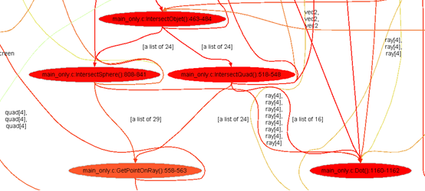
Parallelization of legacy SW code for HW or multi-core implementation
Reference algorithm is often in C
Algorithmic design team separate (often different company) from HW implementation or multi-core SW implementation team
Automated parallelization is still a dream…
Manually-driven computer-aided parallelization
Dataflow profiling shows dependencies and potential for pipeline and “doall” parallelization
Target:
HW SystemC threads
SW pthreads
OpenMP pragmas
Contact: Mihai Lazarescu (mihai.lazarescu@polito.it)

Slide 17
Model-based Wireless Sensor Network design
WSN: cheap sensor nodes, ubiquitous sensing
Application development is expensive, requires broad knowledge
Goal: enable domain expert (not telecom or electronics engineer) to rapidly and efficiently design a WSN application and generate code for target node
Functional specification using Stateflow/Simulink or UML
Code generation for:
Functional simulation
Hardware-in-the-loop simulation
Final deployment
Contact: Luciano Lavagno (luciano.lavagno@polito.it)

Slide 18
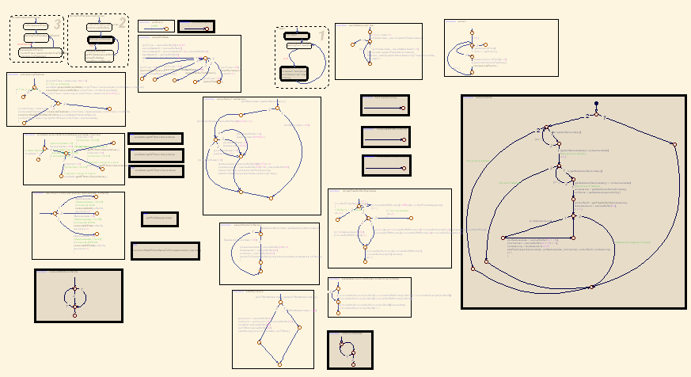
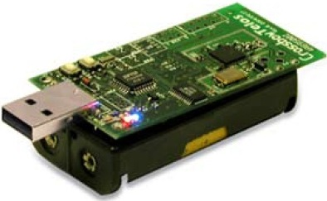
Model-based Wireless Sensor Network design
WSN: cheap sensor nodes, ubiquitous sensing
Application development is expensive, requires broad knowledge
Contact: Luciano Lavagno (luciano.lavagno@polito.it)
WSN Application
Real Nodes
Comm. Msg
Stub Node
Host PC

Slide 19
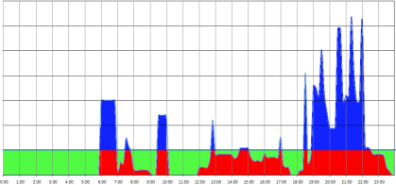
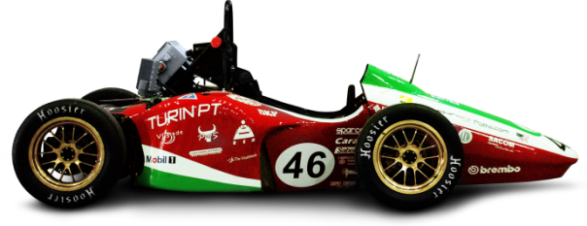
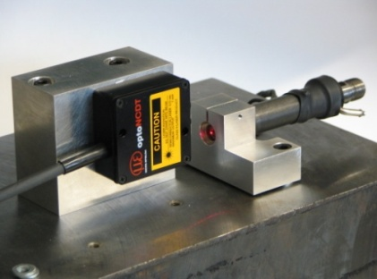
Embedded systems and control algorithms for mechatronics
Energy scavengers and storage systems:
Distributed domestic and industrial peak power-shaving systems based on batteries / flywheels
Energy storage systems for predictive production of non continuous renewable sources (solar, wind, mini/micro hydro)
High performance energy recovery systems for Formula1 race vehicles
Advanced power-train solutions:
Extended autonomy for UAV systems
Hybrid/electric power trains
Innovative injection control systems (piezo injectors)
Contact: Marcello Chiaberge (marcello.chiaberge@polito.it)

Slide 20
Research expertise portfolio
Devices
Nanoscale devices
Quantum-dot light-emitting devices
Organic electronics
Solar cells
Circuits
Asynchronous circuits
Latency-insensitive circuits
Optical circuits
Analog electronics
Microwave electronics
Methods/tools
Electro-Magnetic Compatibility analysis and optimization
High-level synthesis
Wireless Sensor network design tools
Technology CAD
Systems
Nano-satellites
Mechatronic systems
Wireless sensor networks
Smart sensors
Artificial Neural Networks

